Slide 1


EXTERNAL SORT
GROUP 11 - Members
EVANS ACHEAMPONG – 10987644
Amoah Ofori Darkwah - 10949533
Edward Ayirebi Acquah - 10986982
Bani Beres Etornam - 10948391
Eyram Aheto - 10987509

Slide 2

Presentation Overview
This presentation provides an in-depth exploration of external sorting techniques, algorithms, implementation considerations, and real-world applications
Definition of External Sort: External sort is a technique used in computer science and data processing to efficiently sort large datasets that cannot fit entirely in primary memory , requiring the use of secondary memory
Purpose of External Sorting: External sorting is essential for managing and organizing vast amounts of data, enabling efficient retrieval, analysis, and storage

Slide 3

Internal Sorting vs. External Sorting
Explanation of Internal Sorting: Internal sorting pertains to sorting algorithms that operate entirely within the main memory, making it suitable for smaller datasets
Comparison between Internal and External Sorting: Memory Requirements: Internal sorting necessitates enough memory to accommodate the entire dataset, while external sorting handles datasets larger than the available memory
Scalability: External sorting exhibits high scalability as it can handle datasets of any size, whereas internal sorting is limited by available memory

Slide 4

Advantages and Disadvantages of External Sorting
Advantages: Facilitates sorting of large datasets, enables scalability, supports efficient disk-based operations, and permits external merge operations
Disadvantages: Slower performance due to disk I/O operations, requires meticulous implementation to optimize efficiency

Slide 5

Basic Concepts of External Sorting
Primary Memory: Refers to the computer's RAM, which provides limited capacity but offers fast access
Secondary Memory: Refers to external storage devices, such as hard disks, which offer larger capacity, but slower access compared to RAM

Slide 6
External Sorting Process
Sorting: Applying an internal sorting algorithm to each partition
1
Partitioning: Dividing the dataset into smaller chunks that fit in memory
2
Merging: Combining the sorted partitions into a single sorted output
3

Slide 7
Best Practices
Optimize
Minimize disk I/O by carefully managing buffer sizes and employing efficient I/O strategies, such as prefetching and write buffering
Utilize
Leverage parallel processing techniques to distribute sorting tasks across multiple processors or threads for improved performance
Analyze
Analyze data distribution patterns to ensure balanced partitioning and reduce the impact of data skew during merging
Memory Efficiency
Optimize memory usage by employing appropriate data structures, such as priority queues to manage data during sorting and merging.

Slide 8

Real-World Challenges
Fault Tolerance :
In distributed systems, failures such as machine crashes or network disruptions can occur.
Heterogeneous Hardware:
Different machines or nodes may have varying hardware capabilities. This can lead to variations in disk access speed, memory capacity, computational power.

Slide 9

Real-World Challenges
Data Integrity and Recovery:
External sorting involves reading and writing data to disk, which introduces the risk of data corruption or loss.
Security and Privacy:
Sorting large datasets often involves sensitive or confidential information. Ensuring data security during external sorting is a significant challenge.

Slide 10

External Sort Algorithms
Merge Sort
Algorithmic Steps: Divide the dataset into smaller partitions, sort each partition in memory, and merge the partitions using a merge operation
Performance Characteristics: Guarantees efficient external sorting and is often the preferred algorithm for large datasets

Slide 11
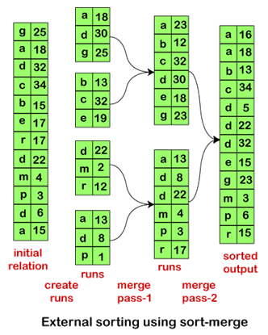

Slide 12

External Quick Sort
Algorithmic Steps: Select a pivot element, partition the dataset into two partitions based on the pivot, recursively sort each partition, and combine the sorted partitions
Performance Characteristics: Quick Sort can for external sorting by employing techniques pivot selection

Slide 13
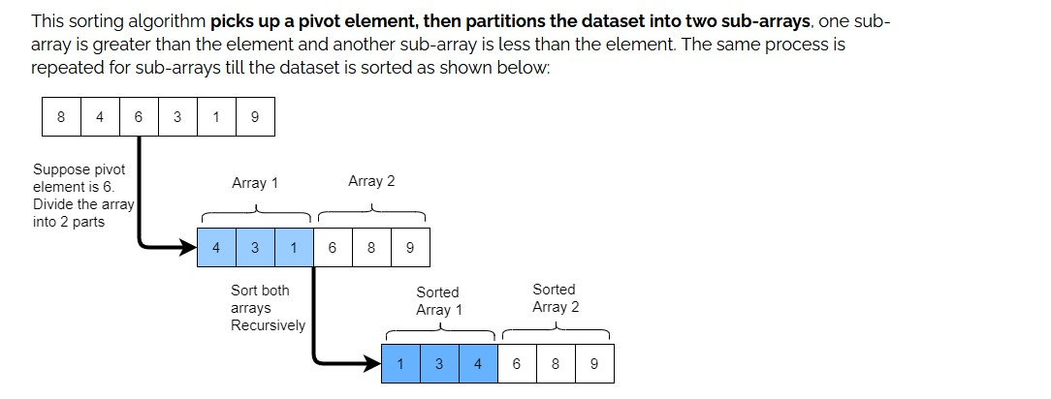

Slide 14

External Sort Techniques

Slide 15
Replacement Selection
Technique: Select a subset of the dataset that fits in memory, sort it using an internal sorting algorithm, and write it back to the disk
Advantages: Reduces disk I/O by performing in-memory sorting
Limitations: Requires multiple passes over the dataset for sorting

Slide 16
Multiway Merge
Technique: Merge more than two partitions simultaneously to reduce the number of merge passes
Advantages: Reduces disk I/O operations and improves sorting performance
Limitations: May increase memory usage during the merge phase

Slide 17

Implementation Considerations
Buffering Strategies: Optimize buffer size selection to minimize disk I/O operations.
I/O Strategies: Efficient disk read and write operations, such as prefetching and write buffering.
Memory Management: Proper utilization of available memory for partitioning, sorting, and merging operations.

Slide 18

External Sort Limitations
Slower Performance: External sorting involves additional disk I/O operations, which can impact overall sorting speed
Disk Space Requirements: External sorting sufficient disk space to store intermediate the final sorted output
Implementation Complexity: Designing and implementing efficient external sorting algorithms can be complex and require careful considerations
Dependency on Hardware: External sorting performance is influenced by the speed and characteristics of the underlying hardware, such as disk access time and memory capacity

Slide 19
Optimization Techniques
Caching: Utilizing cache memory to store frequently accessed data and reduce disk access
Parallel Processing: Employing parallelism to distribute sorting tasks among multiple processors or threads
Compression: Applying data compression techniques to reduce disk I/O and improve sorting performance

Slide 20

Error Handling and Fault Tolerance
Checkpointing
Periodically saving intermediate results to disk to enable resuming from the last checkpoint in case of failures
Redundant Sorting
Duplicating the sorting process on multiple machines or nodes to ensure fault tolerance and data integrity

Slide 21

Error Handling and Fault Tolerance
Data Validation
Verifying data integrity by performing checksums or using error detection and correction codes

Slide 22
Time Complexity in External Sorting
Partitioning: O(n), where n is the number of elements in the dataset.
Sorting: O(n log n) per partition, where n is the number of elements in each partition.
Merging: O(n log M), where n is the total number of elements and M is the available memory capacity.

Slide 23
Space Complexity in External Sorting
Buffer Size: O(B) , where B is the size of the buffer or available memory
Disk Space: O(n) , where n is the number of elements in the dataset
Note: The actual time and space complexity may vary depending on the chosen external sorting algorithm, data distribution, buffer size, and hardware characteristics

Slide 24
Real-World Applications
Large Datasets: Sorting large volumes of data in various domains such as scientific research, financial analysis, and customer analytics
Database Operations: Sorting query results, indexing, and data export operations in databases
Big Data Processing: Sorting data in distributed computing environments.
Importance of External Sorting in These Applications: External sorting enables efficient processing of large-scale data, improves query performance, and enhances overall system scalability

Slide 25

Challenges in External Sorting
Memory Management: Balancing memory usage between partitioning, sorting, and merging operations to maximize efficiency
Data Skew: Uneven distribution of partitions, leading to imbalanced merge phase
Scalability: Ensuring efficient sorting for extremely large datasets that exceed the capacity of a single machine or storage device

Slide 26

Addressing the Challenges
Memory Management:
Optimizing buffer size to minimize disk I/O operations and maximize memory utilization
Implementing efficient memory allocation strategies for partitioning, sorting, and merging operations
Data Skew:
Performing dynamic load balancing to evenly distribute the workload during the merge phase
Scalability:
Implementing parallel external sorting algorithms that leverage multiple processors or nodes for faster sorting
Utilizing distributed computing frameworks to process and sort data in a distributed manner

Slide 27

Conclusion
External sorting is essential for handling large datasets that exceed available memory capacity.
It enables efficient sorting by utilizing disk-based storage and partitioning, sorting, and merging techniques.
External sorting algorithms and techniques optimize performance and scalability while mitigating disk I/O challenges.
Industry applications span various domains, including finance, e-commerce, scientific research, and healthcare

Slide 28

QUESTION TIME

Slide 29

THANK YOU

